Slide 1
Macroeconomics II
Lecture 08 (March 2023)
Romer model
Extensions

Slide 2
Theoretical Lecture 08
The Romer model
the model of endogenous growth by Romer: main assumptions;
production function;
production of new ideas and productivity of research (externality due to duplication; the spillover effect of research);
economic growth in the steady state;
long-run effect of research policy.
Reading
Jones, C., Vollrath, D. (2013), Introduction to Economic Growth, Norton, ch. 5, pp. 97-119.

Slide 3
The exogenous models of economic growth:
main concepts
The Solow model: exogenous model of economic growth, with
1. the concept of steady state; there are endogenous mechanisms that drive the economy towards the steady state:
2. substitutable production factors;
3. capital accumulation is characterized by diminishing returns (declining marginal product of each unit of capital).
Thus, in the steady state, the economy grows due to exogenous factors (technological progress at the rate “g”; population at the rate “n”), which are not “explained” by the model;
in the Solow model, economic policy has only temporary effects on the rate of economic growth; it has no long-run effects on the rate of economic growth.

Slide 4
As growth theory changed since the 1950s:
Departing from the neoclassical models (Solow, etc), in the 1950s and 1960s:
1. we had an exogenous savings (= investment) rate (crucial to explain the steady
State income level) (question: is there a social planner who decides?)
2. technological progress is exogenous (crucial to explain the long-run per capita
growth rate) (question: does the technological progress come from heaven?)
and these are called exogenous growth models
They are unsatisfactory and ignited two theoretical reactions:
A. growth models with endogenous savings (mid 1960s)
Cass (1965) and Koopmans (1965), that go back to Ramsey (1928), Young (1928),
Knight (1944)
B. growth models with endogenous technological progress (mid 1980s)
Arrow (1962), Romer (1986, 1987, 1990), Lucas (1988), Rebelo (1991)

Slide 5
Therefore, a new growth theory in the 1970s
After the 1950s: a great vacuum of growth economic theory of about 15 years!
In the 1970s, the main emphasis is on short-term analysis (real business cycles, rational expectations, general equilibrium models, etc);
The framework of these models is a very technical approach and very little empirical applications;
Instead, development economists emerged with great emphasis on the study of growth in less developed countries;
A great split:
growth economics vs. development economics

Slide 6
The new models of endogenous growth
The models of exogenous growth are not adequate to explain economic growth if
the long-run growth rate of GDP is explained by (endogenous) technological progress
In the 1970s and up to the mid-1980s, macroeconomics was focused mainly
in short term issues.
By mid-1980s some economists made theoretical work devoted to fill gaps in the
explanatory models of growth; for instance Romer (1986, 1987) deals with
Technological progress as an endogenous variable (the process of generation
of new ideas, research and innovation, R&D);
These models tend to consider as well population growth as an endogenous
variable (dependent on GDP per capita)
6

Slide 7
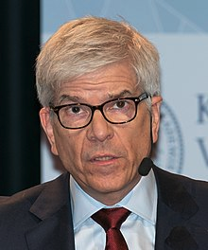
The endogenous growth models consider the creative role of technological progress
Given the difficulty of incorporation of technological progress in neoclassical models, given ignoring the creation of new ideas
(which are not competitive goods, since imperfect
competition/ideas are quasi-public goods)
The main contributions by Paul Romer (Nobel Prize, 2018):
Romer, P. (1986). “Increasing returns and long-run growth”. Journal of Political Economy, 90: 6 (Dec.), 1257-1278
Romer, P. (1990). “Endogenous technological change”. Journal of Political Economy. 98:5 (October), Part II, S71-S102
He is the author of the incorporation of R&D theories and imperfect competition into the growth models, the reason for the Nobel.
7

Slide 8
The endogenous growth models: the role of technological progress (cont.)
They incorporate Schumpeterian ideas of technological progress (as “creative destruction”)
+ new lines of research:
Diffusion of technology and its role in economic growth (a line of empirical research in progress);
Notice the relevance of Foreign Direct Investment and its growth in the last decades
8

Slide 9
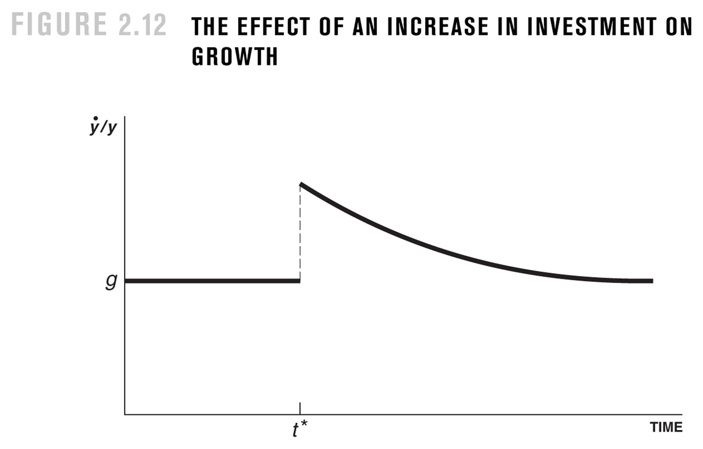
Remember the
Solow model:
the rise of the investment rate
has no effect on the long-run
growth rate of GDP per capita
9

Slide 10
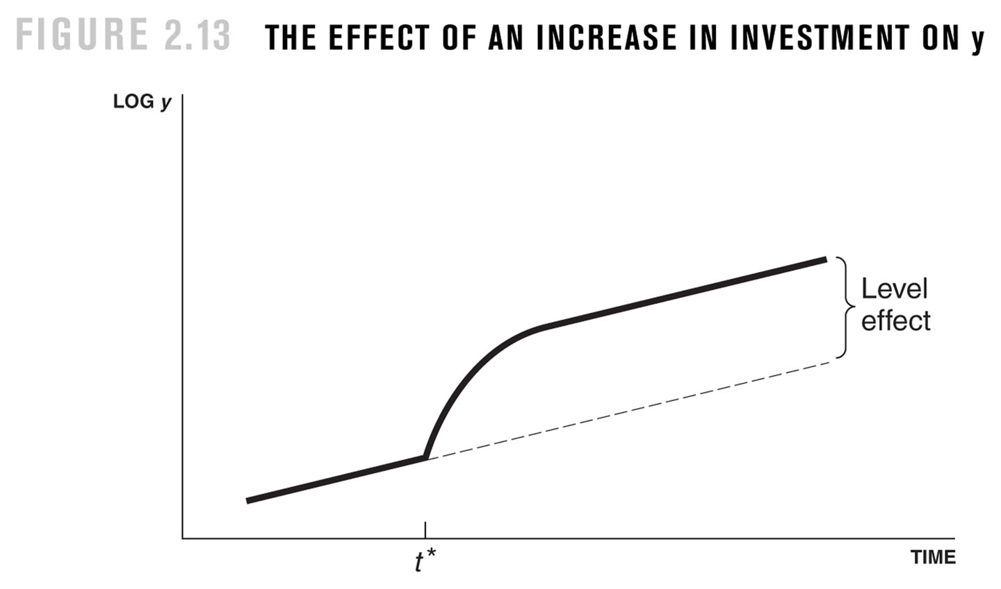
Remember the Solow model:
the rise of the investment rate
has positive effect on the long-run level of GDP per capita
10

Slide 11
The Romer model
To endogenize the technological progress: research as an economic activity (R&D)
production function:
(1) Y = K^{α} (A.L_{Y})^{1-α}
A(t) – level of technology in the economy, which is measured by the stock of ideas
accumulated until the present; the model intends to explain the growth of A(t).
for a given level of technology A, the production function has constant returns to
scale in K e L_{Y} (Labour in the production of final goods)
A is an input for production (stock of ideas: i.e., the use of patents)
The production function has increasing returns to scale in K, L_{Y} and A

Slide 12
the generation of the inputs:
physical capital (K), labour (L) and ideas (A)
physical capital
(2) dK/dt = s_{k}Y – δK
labour
(3) (dL/dt)/L = n n is exogenous
(4) L = L_{Y} + L_{A} labour in the production of final
goods (L_{Y}) and in research (L_{A})
(5) L_{A}/L = s_{R} s_{R} constant

Slide 13
A(t), the growth of the stock of ideas is endogenous:
dA/dt = θ*. L_{A} in which
dA/dt is the evolution of the discovery of new ideas
θ* productivity of research (the rate of producing new ideas by the researchers)
L_{A} number of researchers
and θ*= θ(A), the productivity of researchers is a function of the stock of ideas
increasing function? a large set of accumulated ideas facilitates the discovery of new ideas; positive spillover (what has been discovered facilitates new ideas);
decreasing function? given a large set of accumulated ideas, it becomes more difficult to discover “new” ideas (since so much is already known …)
θ* = θ . A^{Φ} rate at which new ideas are produced, with Φ > 0
(increasing) or Φ < 0 (decreasing)

Slide 14
θ*= θ(L_{A}), the productivity of the researchers is a function of the number of researchers
The reason: a large number of researchers facilitates the creation of research networks the ability of each research and his/her team to make better research (then λ> 1)
But also there is an externality associated to duplication: some ideas may be not new ideas, since they may have been already discovered by other researchers (then λ < 1)
then we have, dA/dt = θ.L^{λ}_{A}.A^{Φ} using L^{λ}_{A} because the productivity of research depends on the number of researchers looking for new ideas.
In which λ < 1 (if there is a duplication effect), or λ > 1 (if the network effects prevail)
Φ < 0 (if it decreases with A), or 1> Φ > 0 (increasing with A, if there is a spillover effect)

Slide 15
The Romer model summed up
(1) Y = K^{α} (A.L_{Y})^{1-α}
(2) dK/dt = s_{k}Y – δK
(3) (dL/dt)/L = n
(4) L = L_{Y} + L_{A}
(5) L_{A}/L = s_{R}
(6) dA/dt = θL^{λ}_{A}.A^{Φ}

Slide 16
The growth of the economy in steady state
Assuming s_{R} constant, the growth of GDP per capita in steady state is explained by
the technological progress (as in Solow model):
g_{y} = g_{k} = g_{A}
What is (and what explains) the rate of technological progress, g_{A}?
Reminder: this growth rate is endogenous in the model!
dA/dt = θL^{λ}_{A}.A^{Φ}
(dA/dt)/A = θ . (L^{λ}_{A}.A^{Φ})/A = θ . L^{λ}_{A}.A^{Φ-1}
or g_{A} = θ . L^{λ}_{A}.A^{Φ-1}

Slide 17
The rate of technological progress in steady state (cont):
g_{A} = θ . L^{λ}_{A}A^{Φ-1} = θ . L^{λ}_{A}/A^{1-Φ}
In the steady state g_{A} is constant: the growth rate of the numerator equals the growth rate of denominator. Then taking the growth rates:
λ . (dL_{A}/dt)/L_{A} = (1 – Φ) . (dA/dt)/A
Or, in the steady state, in which (dLA/dt)/L_{A}= n (growth rate of population)
λ . n = (1 – Φ) . g_{A}
And we get the technological progress g_{A} = λ . n / (1 – Φ)
g_{A} is explained by the parameters of the production function of ideas (λ and Φ) and the growth rate of population (n)

Slide 18
g_{A} = λ . n / (1 – Φ)
interpretation
let the special case λ = 1 and Φ = 0 (for an easier explanation)
then: dA/dt = θ . L_{A}, from equation (6)
In each period, θ.L_{A} new ideas emerge but, for a certain L_{A}, at a decreasing rate (given θ<1). The growth rate of A, g_{A}, in this case of λ=1 and Φ=0 is constant (g_{A}= λ). The alternative to get an increasing growth g_{A} is to prevent the decrease of the number of researchers. This requires the population to rise and explains n in the equation above.
conclusion
If the population does not increase, economic growth will not happen, even keeping research activity and technological progress in the economy.

Slide 19
Effects of Economic Policy
Economic policy may have effect on long-run economic growth?
An example of an economic policy measure: incentives to research, creating/increasing research subsidies; rise of s_{R}
(dA/dt)/A = = θ . L^{λ}_{A}/A^{1-Φ}
let us assume that λ = 1 and Φ = 0
then:
(dA/dt)/A = θ . L_{A}/A = θ . s_{R} . L / A
We know that in steady state, with λ = 1 and Φ = 0, g_{A} = n
What is the effect of a policy of incentives to research by rising s_{R}?

Slide 20
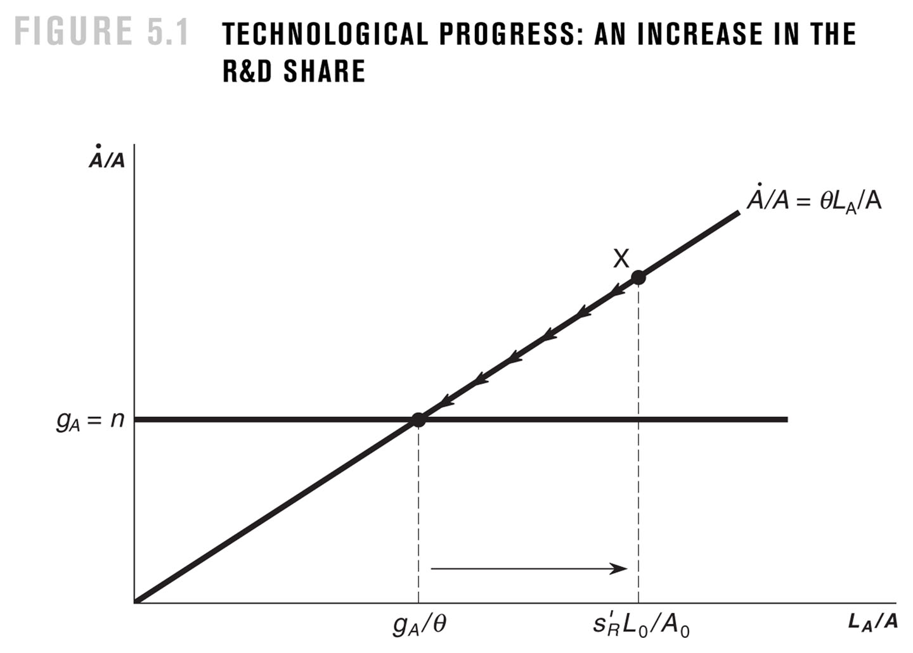
If s´_{R} > s_{R} then s_{R} increased (number of researchers in I&D)
s´_{R}.L0 > s_{R}.L0, the number of ideas increases;
technological progress >
population growth (n)
=> L_{A}/A decreases
=> g_{A} decreases
the economy returns to the previous steady state
steady state: θ . s_{R} . L₀/A₀ = g_{A} => s_{R} . L₀/A₀ = g_{A}/θ
Notes:
FIGURE 5.1 TECHNOLOGICAL PROGRESS: AN INCREASE IN THE R&D SHARE

Slide 21
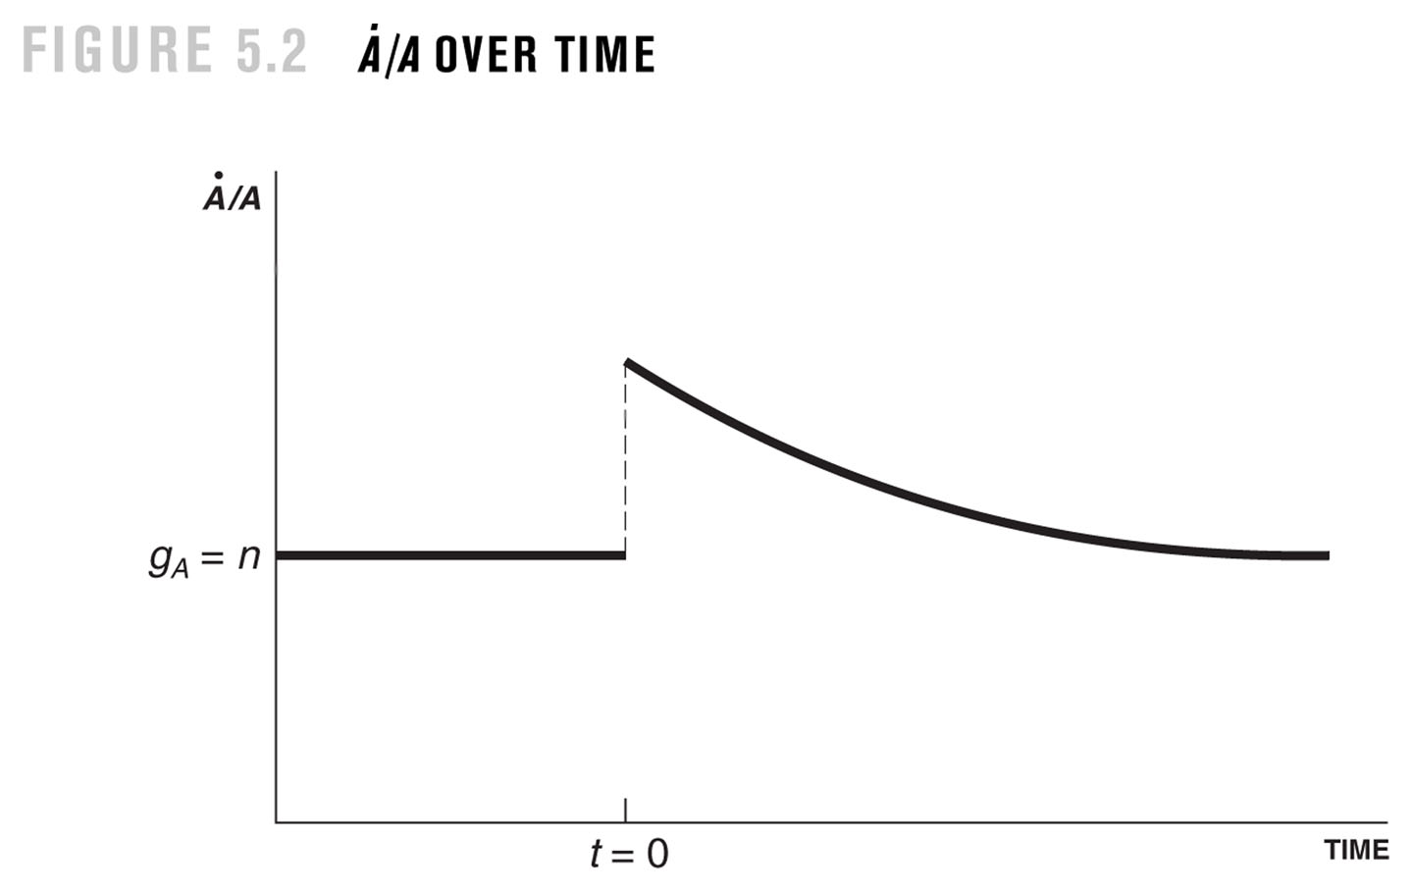
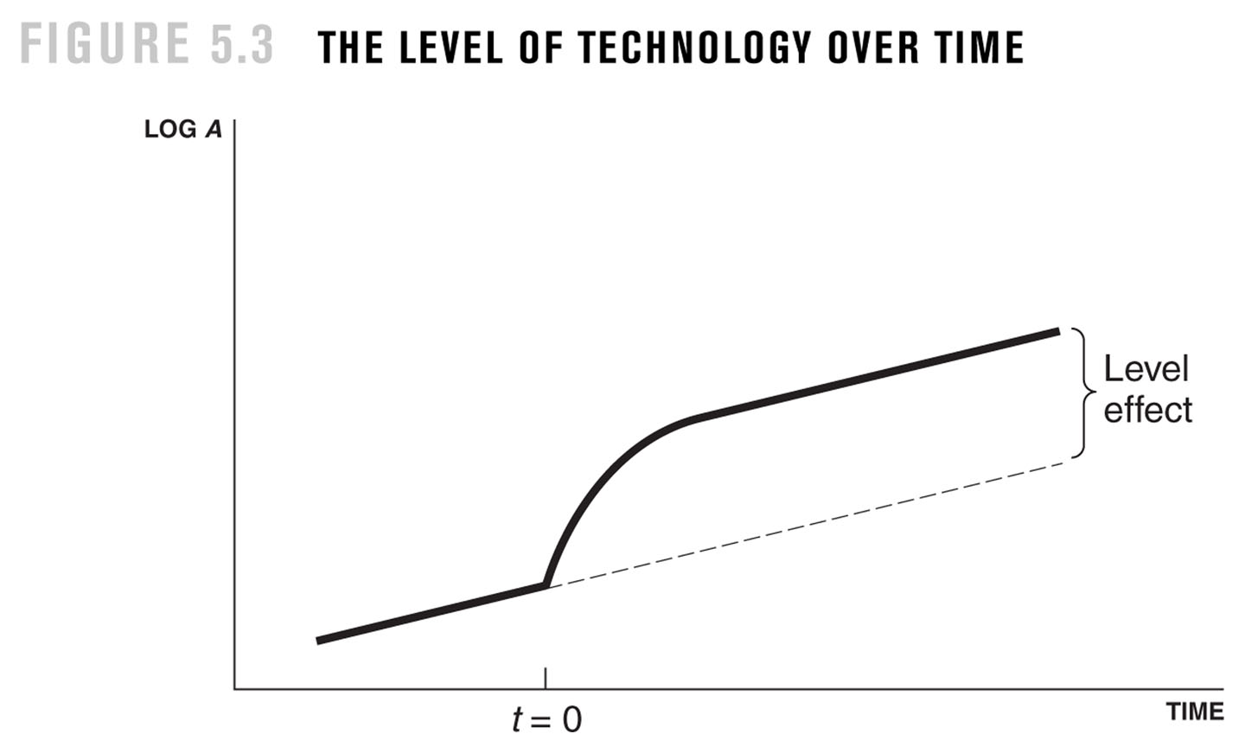
A permanent increase of s_{R} increases the technological progress (and economic growth) only in a temporary way, not permanently in the long-run.
But it increases permanently (in the long-run) the level of technology.

Slide 22
technological progress and growth
(to remind)
growth accounting: growth of factors and of TFP (total factor productivity)
growth of TFP through technological progress
technological progress in the models of exogenous growth
growth in steady state: rate g
rate g is exogenous
technological progress in the models of endogenous growth
rate g is endogenous
technological progress is “explained” by the working of the economy
(it is an output of a sector of economic activity)

Slide 23
Facts and concepts, technological progress: invention and innovation
invention: discovery of new ideas
innovation: implementation of the new ideas in the economic activity
inovation
microinventions
macroinvention (radical change of technology)
r
t
23

Slide 24
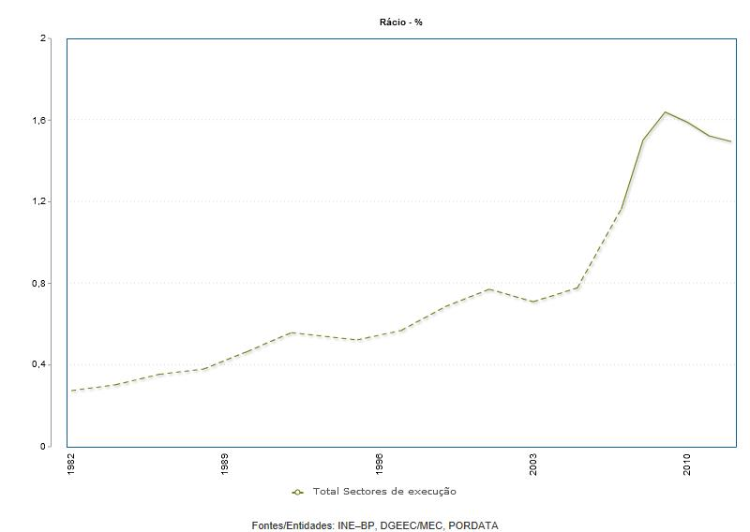
PORTUGAL: Expenditure on R&D as % of GDP
24

Slide 25
The Romer model (summary)
Its main contribution, to endogenize the technological progress, namely through:
The production function (ideas/”knowledge” are a production factor)
equations to describe the creation of inputs (including the ideas/”knowledge”)

Slide 26
(1) Y = K^{α} (A.L_{Y})^{1-α}
(2) dK/dt = s_{k}Y – δK
(3) (dL/dt)/L = n
(4) L = L_{Y} + L_{A}
(5) L_{A}/L = s_{R}
(6) dA/dt = θ*. L_{A}
(7) θ* = θ . A^{Φ}
dA/dt = θL^{λ}_{A}.A^{Φ}
constant returns to scale in K and LY;
increasing returns in K, LY and A.
A(t) stock of knowledge
(number of ideas invented until moment t)
θ* productivity of research (nr. of new ideas
produced per researcher)
0 < λ < 1 externality associated with duplication
Φ > 0 positive knowledge spillover in research
some of the ideas created by a researcher may be not new (λ<1); but may also exist a network effect (λ>1)
much of what has been discovered
so far facilitates the generation of
new ideas (positive spillover); a large
set of accumulated ideas becomes more
difficult to discover “new” ideas (negative
spillover)

